Slide 1
WHEN TO APPLY & NOT TO APPLY THE BIBLE:
THE BIBLE & ETHICS
ICC Fresno Fellowship
March 17, 2018

Slide 2

Previous outline
Literacy
  In the OT and NT
  Who are the copiers?
Changes in Textual transmission
  Accidental changes
  Intentional theological changes
Canonization of OT
  Septuagint
Canonization of NT
Translations from Greek to English
Which “version” or “translation” of the Scriptures did Jesus use?
Concluding Remarks

Slide 3
Why is the Bible unique ? HARMONY
Demonstrates God’s love
Demonstrates God’s fidelity & perseverance
Demonstrates man’s sins
Focuses on Christ
Points to salvation
Presents ethical frameworks

Slide 4
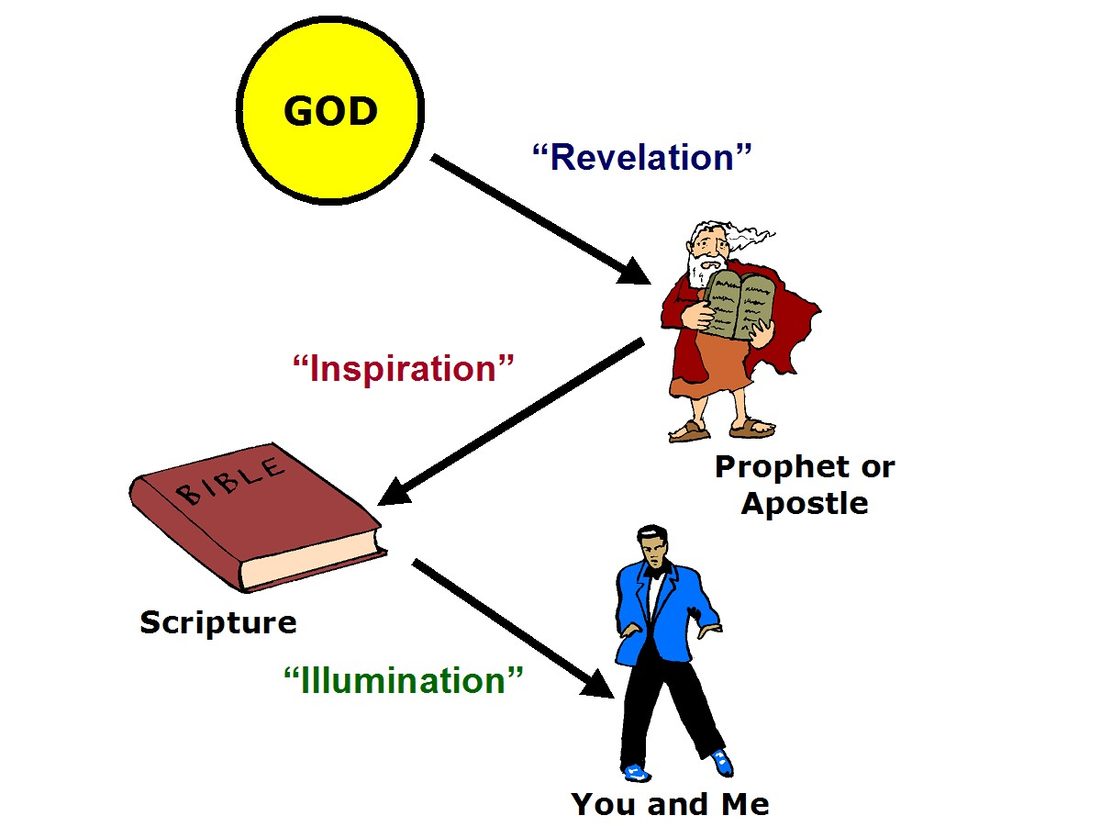
Is the Bible the Word of God or God’s Word?
“infallible”
“inerrancy”

Slide 5
Applying the Bible
7P’s:
  People
  Place
  Points
  Principles
  Present
  Parallels
  Plans

Slide 6
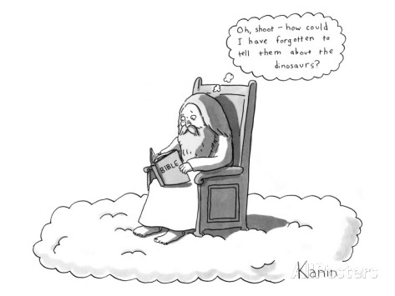
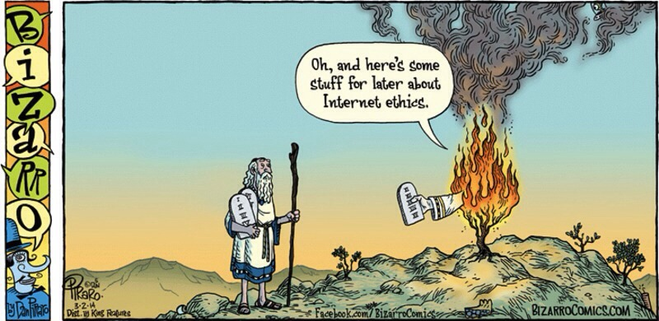
Principles infallible in what ? ??
Theology
Politics
Ethics
Science
History

Slide 7
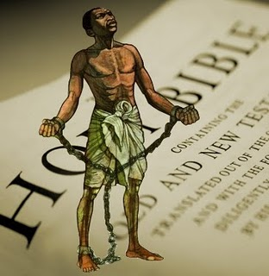

Explicit vs Implicit guide for ethics
Drinking
Drugs
Embryonic stem cell research
Divorce? Deut 24:1-4 & Matt 19:3-12
Paul & slavery: Ephesians 6:5
Deuteronomy 25:11-12

Slide 8
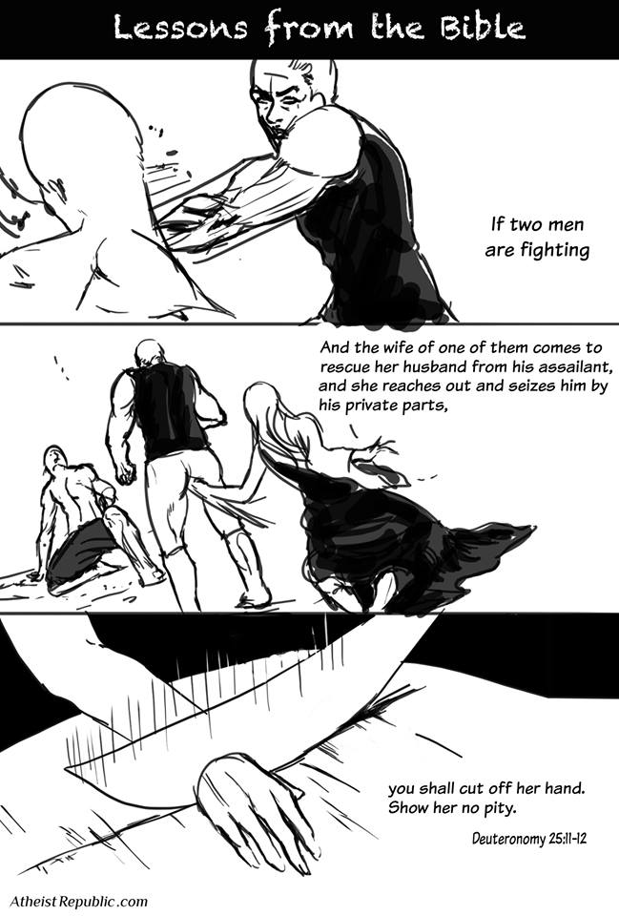

Slide 11
I. Biblical Ethical Models
Classical by Emil Brunner – Divine Imperatives (2)
Developmental – Evolving Ethics
Paradigm-based
  King
  Priest
  Prophet
  Family
  Hospitality

Slide 12
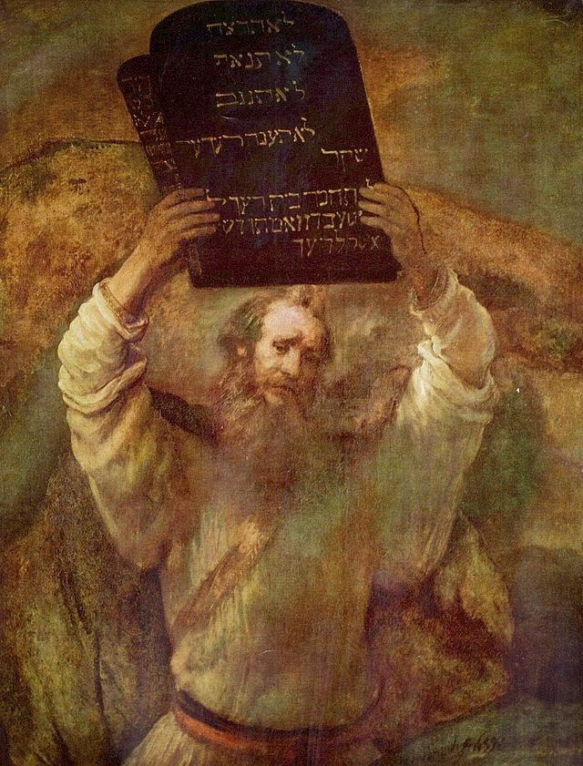
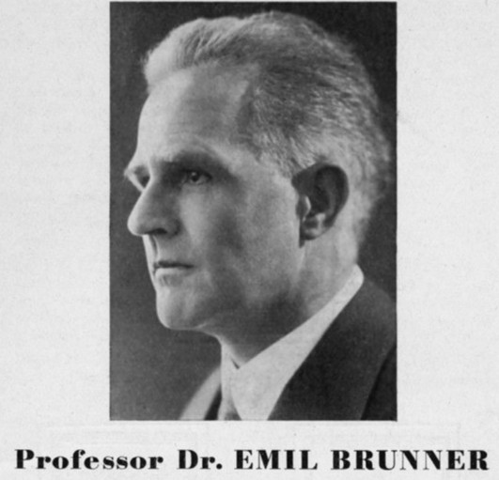
DIVINE IMPERATIVE MODEL

Slide 13
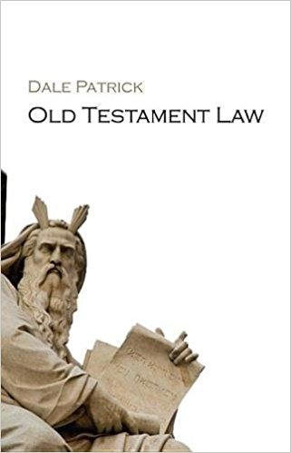
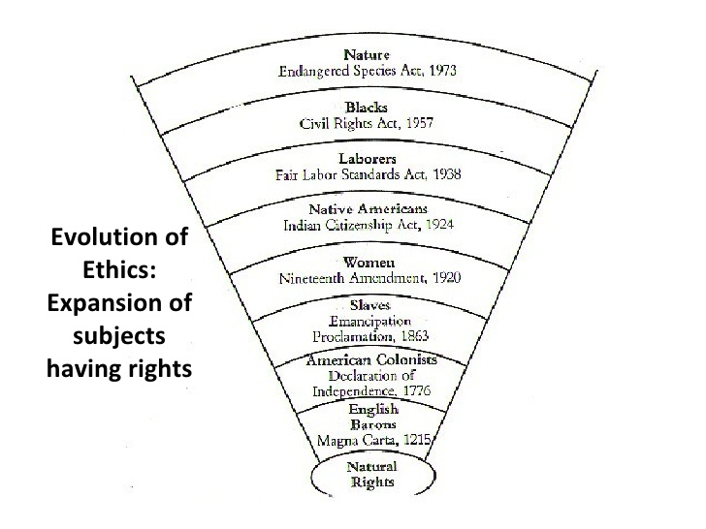
DEVELOPMENTAL ETHICAL MODEL

Slide 14
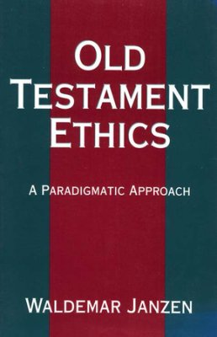
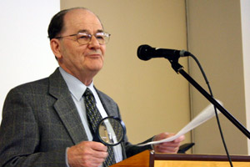
PARADIGMATIC MODEL OF ETHICS

Slide 15
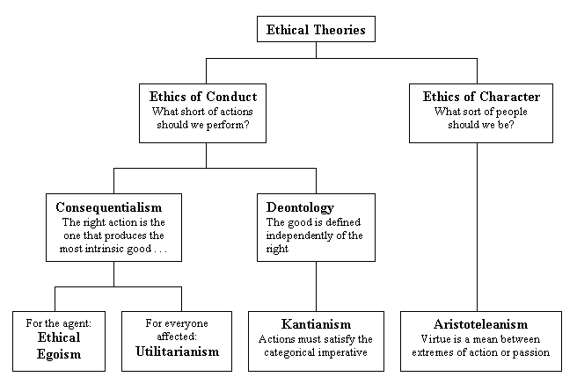
II. Philosophical Ethical Models
Virtue Ethics
Deontological Ethics
  Action-based
  Duty-based
Consequentialism
  Utilitarianism
  Social contract

Slide 16
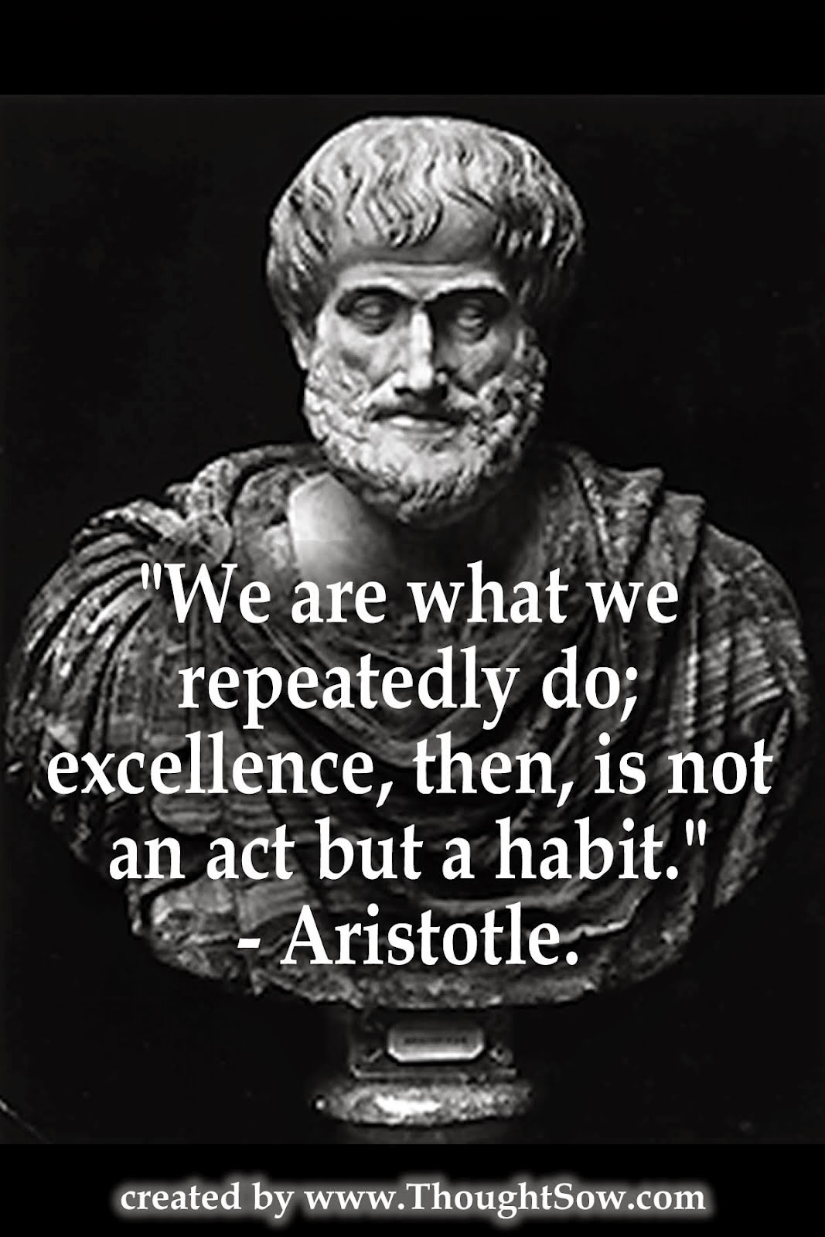
Aristotle’s Ethics
384-322 B.C.
The Nicomachean Ethics
Two Kinds of Persons
  Continent:
    Do what is right, but not necessarily because they want to
  Temperate:
    Do what is right because they want to; the more holistic person

Slide 17

The Doctrine of the Mean
Proper position between two extremes
  Vice of excess
  Vice of deficiency
Not an arithmetic median
  Relative to us and not the thing
  Not the same for all of us, or
  Any of us, at various occasions
  “In this way, then, every knowledgeable person avoids excess and deficiency, but looks for the mean and chooses it” (II.6)

Slide 18
The Mean

Slide 19
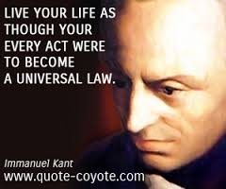
Deontological Theories (Kant)
Actions are guided by moral laws
Morality must be based upon reason
Can explain why an action is right or wrong
Places emphasis on duty and rules that should be followed, ignores consequences

Slide 20
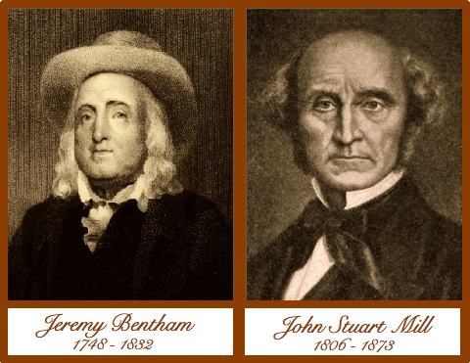
Utilitarianism (Bentham, Mill)
Focus on outcomes, not on motivations
What is the metric or goal here?
  Need an important distinction!
Instrumental vs. Intrinsic goods
Many laws are utilitarian based…

Slide 21
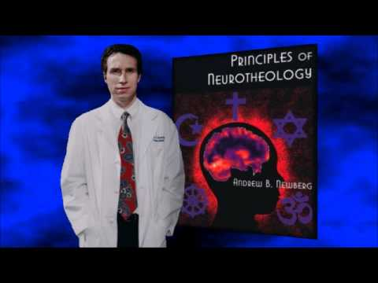
Is there a scientific basis for ethics?
Andrew Newberg, M.D.

Slide 22
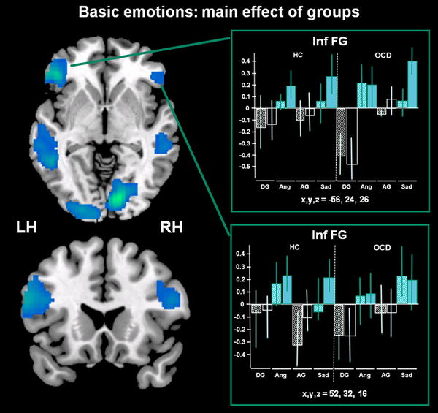
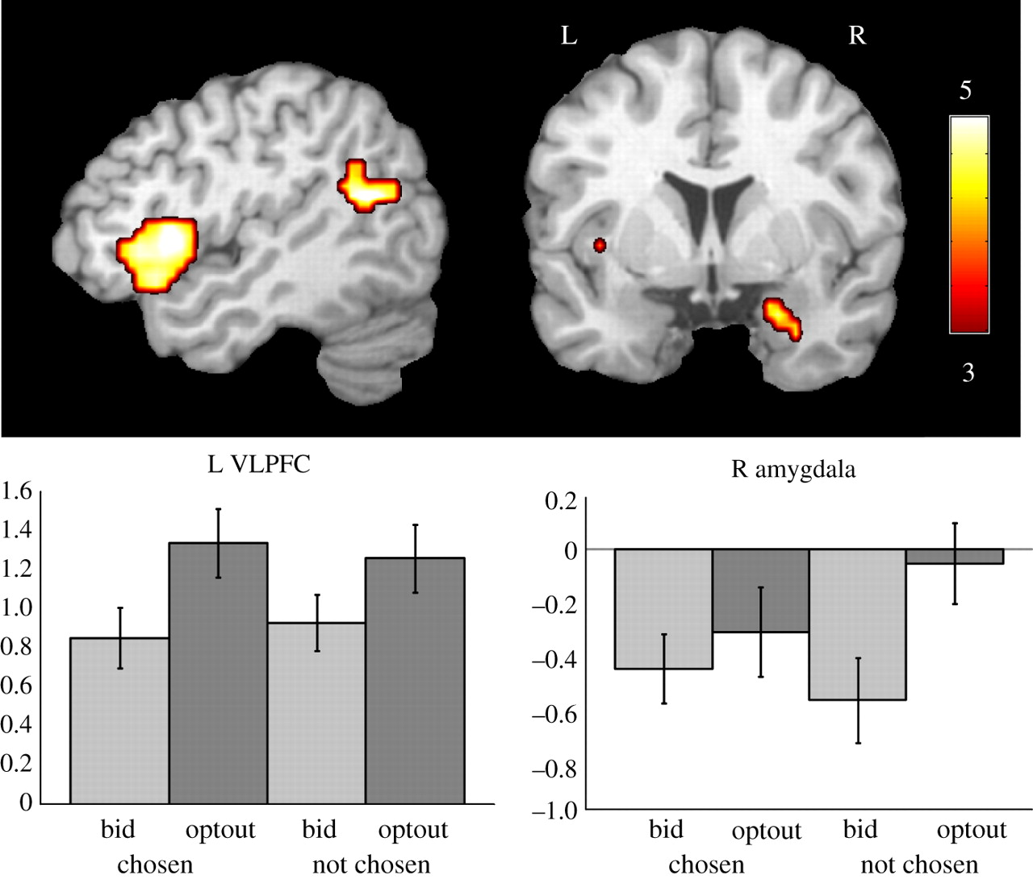
Deontological vs. Utilitarian Brain Activation

Slide 23
III. Major Models of Theological Ethics
Unqualified Absolutism (Anabaptist)
Conflict Absolutism (Lutheran)
Graded Absolutism (Reformed).
Remember: Absolutism states that ethical principles are not only objective features of the world, but that they are always binding on all moral agents and can never be overridden by other relevant moral or non-moral concerns.

Slide 24
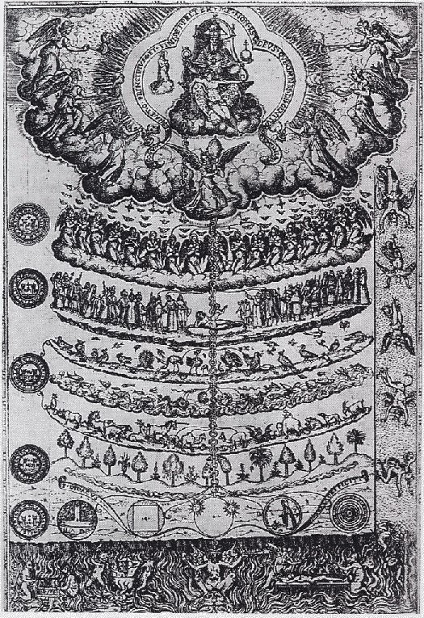
Traditional evangelical models of ethics:
Assumes a certain metaphysical and epistemological framework;
Certain Laws of Logic;
Divine revelation as final and absolute authority.
The importance of living a godly life, not in order to earn salvation, but in gratitude of the grace, God’s unmerited favor, believers have received.
Jesus Christ is the ultimate example of the type of person a believer to emulate (by means of the Holy Spirit).

Slide 25
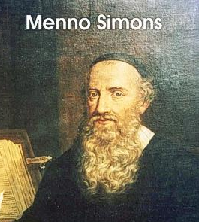
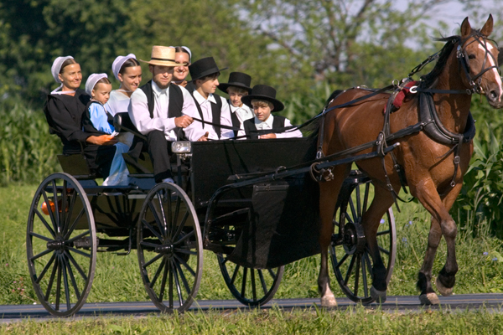
Unqualified Absolutism:
Sin is always avoidable.
Unqualified absolutism which is rooted in the Anabaptist tradition affirms that all moral conflicts are only apparent; they are not real.
Psalm 19:7
Anabaptist – Amish, Mennonites

Slide 26

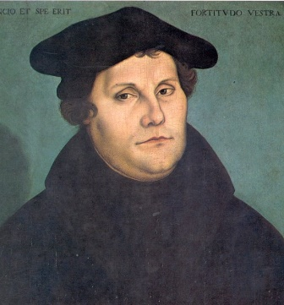
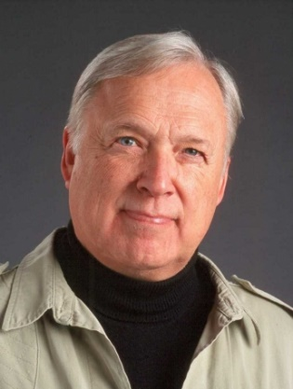
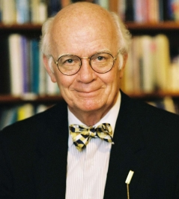
Conflict Absolutism:
Always do the lesser evil.
Conflict Absolutism affirms that moral conflicts are inevitable because we live in a fallen world. When two duties conflict, we are responsible to both duties. God’s law can never be broken without guilt. Therefore, in such cases, we must simply do the lesser evil and confess our sin (1 John 1:9).

Slide 27
Tenets of Conflict Absolutism:
God’s law is absolute and unbreakable (Exod. 20:7; Psalm 19:7, 11; 119:4,160).
In a fallen world unavoidable conflicts between God’s commands occur.
When moral conflict happen, we should do the lesser evil (John 19:11; Matt. 12:32).
Forgiveness is available if we confess our sins (1 John 1:9).

Slide 28
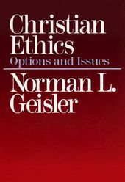
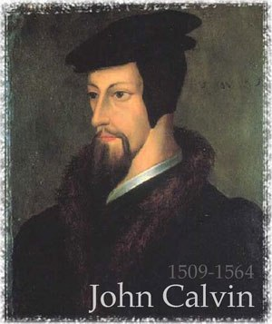
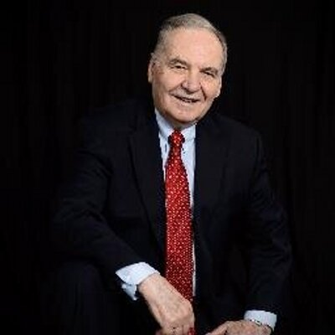
Graded Absolutism:
This view advocates the idea that when two or more universal ethical norms come into unavoidable conflict, the Christian’s non-culpable duty is to follow the higher one. This position maintains that one is personally guiltless if he or she does the greatest good and chooses the lesser evil in a hard case situation. In other words, God grants an exemption to the lower moral law in view of one’s duty to obey the higher one. This is from the Reformed tradition.

Slide 29
Tenets of Graded Absolutism:
Biblical passages used to substantiate higher and lower moral laws:
1. Matthew 22:34-40 to be the clearest indication of higher and lower moral laws with Jesus affirming that the “first” and “greatest” commandment of loving God is of preeminent importance whereas the “second” commandment is loving one’s neighbor.
2. Matthew 23:23 where reference is given to the “weightier” matters of the law;
3. John 19:11 whereby Jesus explained to Pilate that Judas committed the “greater sin” (John 19:11).

Slide 30
Tenets of Graded Absolutism:
Biblical passages used to substantiate higher and lower moral laws:
4. 1 Corinthians 13:13 the author speaks of the “greatest” virtue;
5. Matthew 10:37 states, “He who loves father or mother more than me is not worthy of me” (Matt. 10:37);
6. and other passages that support this hierarchy include Proverbs 6:16; Matthew 5:22; John 15:12; 1 Corinthians 5 cf. 1 Corinthians 11:30; 1 Timothy 1:5; 1 John 5:16 (Geisler, Christian Ethics, 116-17).

Slide 31
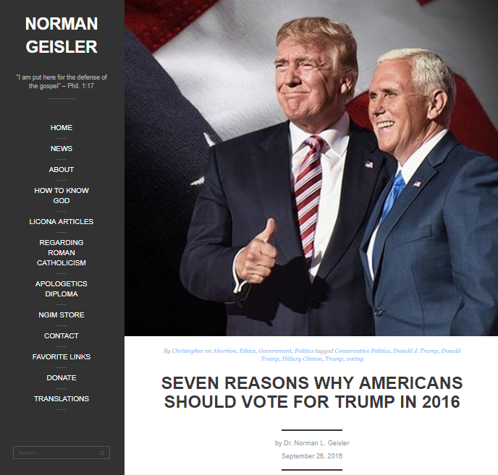
Tenets of Graded Absolutism:
It preserves Moral Absolutes.
It is in touch with the real world of moral conflicts; not every decision is neat and clean.
It sees moral conflicts as rooted in man’s fallen condition.
When moral conflicts are unavoidable, it recognizes maintaining the higher moral law over the lower moral law.
No imputation of guilt if higher moral law if a lower moral absolute was violated.

Slide 32
Summary
Biblical Ethics
  Classical Divine Imperative model
  Moral Developmental model
  Paradigmatic model: King, Priest, Prophet, Family, Hospitality
Philosophical Ethics
  Virtue Ethics
  Deontological Ethics: action-based, or duty-based
  Consequentialism
Theological Ethics
  Anabaptist
  Lutheran
  Reformed
Conclusion: Religionless Ethics

Slide 33
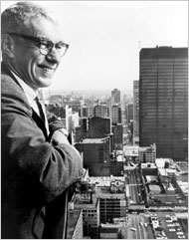
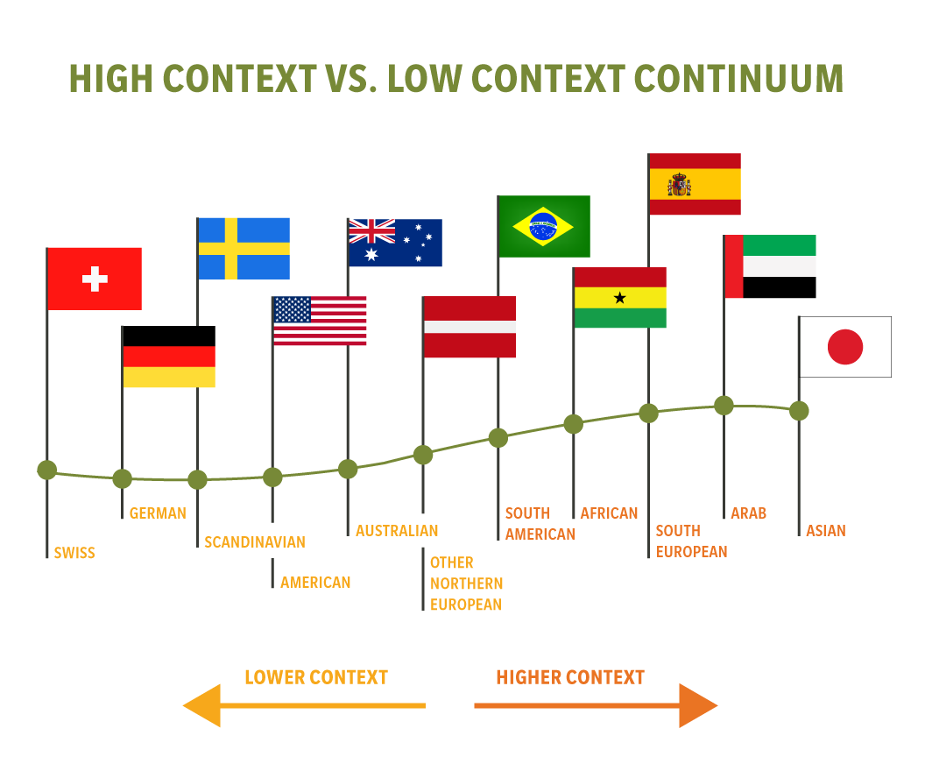

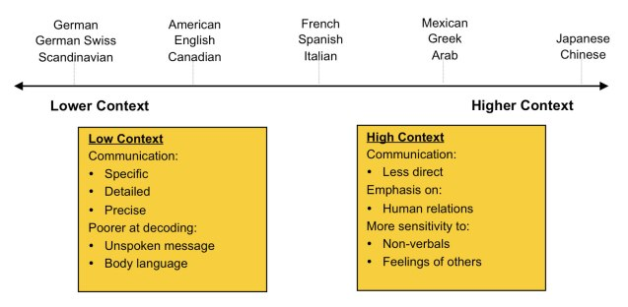
Edward T. Hall, Ph.D.

Slide 34
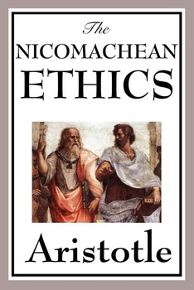
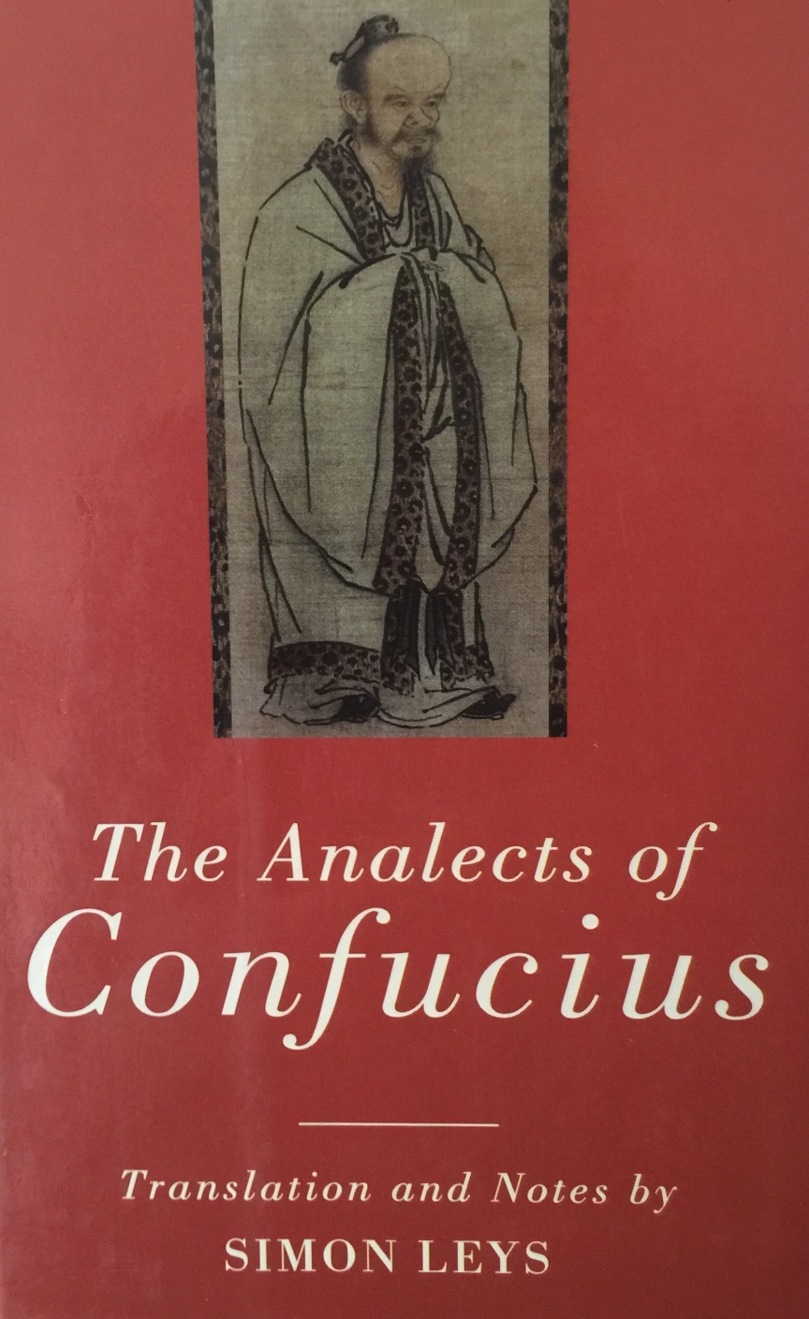
Where is the Bible in this Continuum?

Slide 35
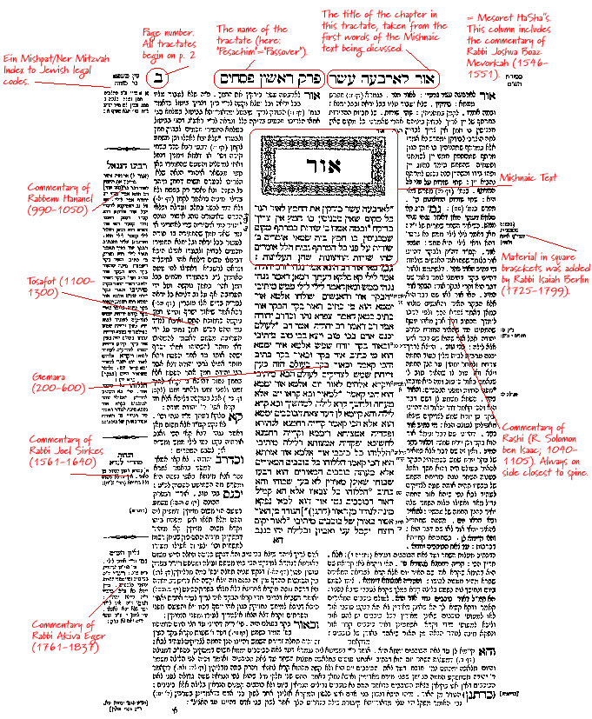
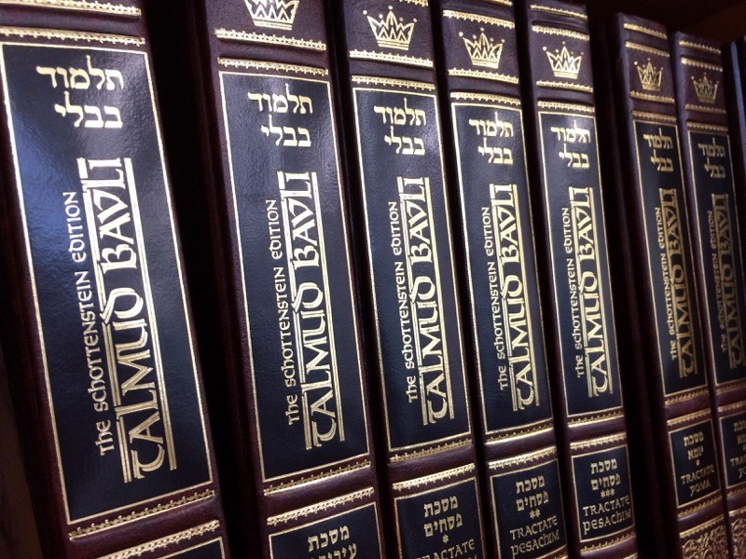
We have to walk with God
A case for Case Law

Slide 36
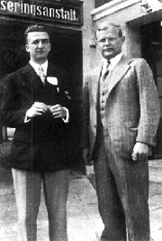
Niebuhr & Bonhoeffer
Ethics arises due to conflict between self and others
Conflict comes from sin, from the broken world
To overcome sin, to overcome conflict, one needs Christ
To know Christ is to transcend ethics
The Bible is all about how to be more Christ-like

Slide 37



Religionless Christian Ethics

Slide 38


Slide 39



Acknowledgments

